Slide 1
GPS module communication BPC-DE2 Project
Created by: Jan Malucha, Richard Panáček, Michal Pernica

Slide 2
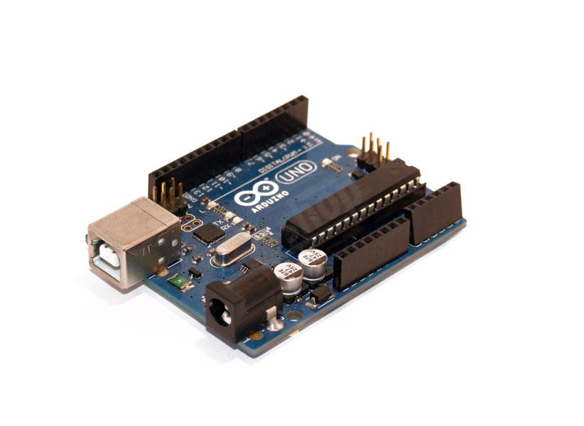
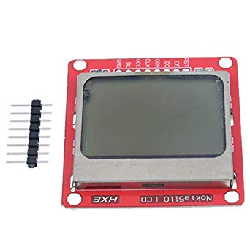
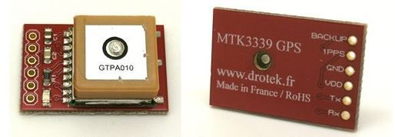
Modules
GPS module PA6H (Drotek Electronics)
Display Nokia 5110
Microcontroller Arduino UNO (ATmega328P)

Slide 3
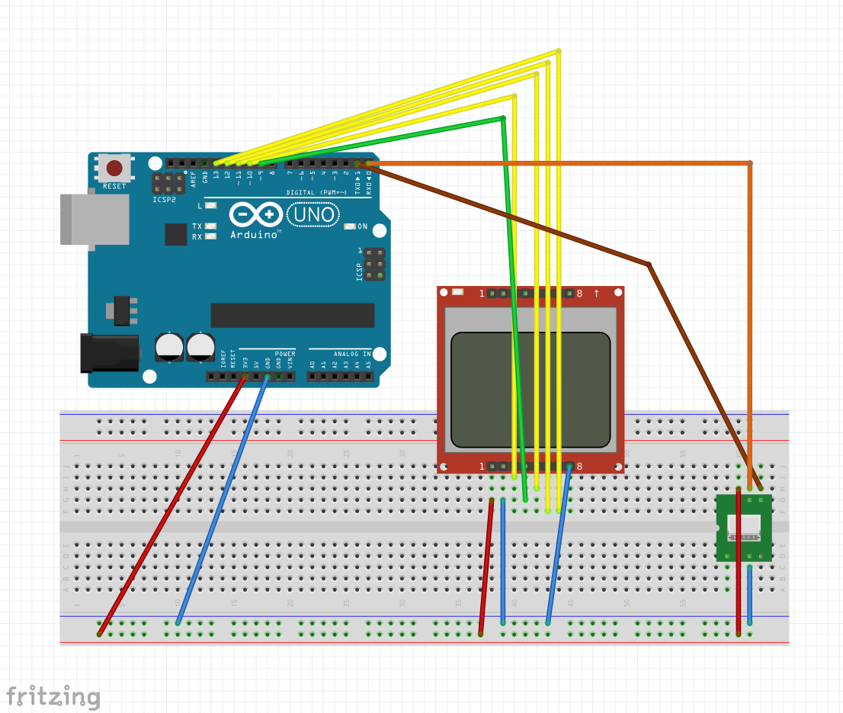
Connecting Modules
Connections between Display and Arduino
RST to PB1
SCE to PB2
DC to PB3
DIN to PB4
CLK to PB5
Power delivery with 3.3 V
Led Backlight to GND
GND to GND
Connections between GPS and Arduino
Rx to Tx (PD1)
Tx to Rx (PD0)
Vin to 3.3 V
GND to GND

Slide 4
Requirements of the projects:
Communication with GPS Data
Storage with export to PC
Displaying data on the Nokia 5110 display

Slide 5
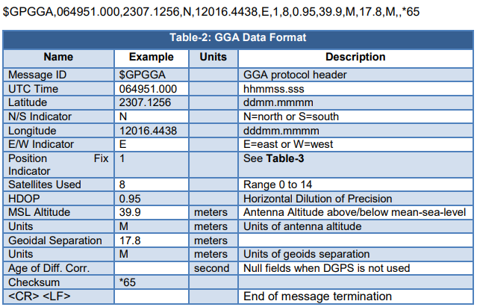
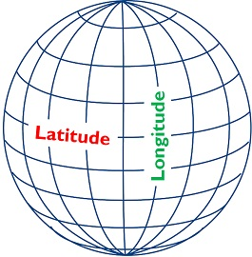
NMEA sentences
$GPGGA,080714.000,4913.6237,N,01634.4839,E,1,8,1.15,276.1,M,43.5,M,,*52
$GPGSA,A,3,01,22,14,03,23,11,19,17,,,,,1.45,1.15,0.88*0F
$GPGSV,3,1,12,22,85,003,12,01,73,146,12,03,65,278,13,11,53,184,13*76
$GPGSV,3,2,12,14,41,057,10,17,34,301,12,23,29,205,11,31,25,091,11*78
$GPGSV,3,3,12,19,21,319,13,32,16,046,14,09,02,214,,08,02,181,*77
$GPRMC,080714.000,A,4913.6237,N,01634.4839,E,0.61,186.44,271119,,,A*68
$GPVTG,186.44,T,,M,0.61,N,1.14,K,A*31

Slide 6
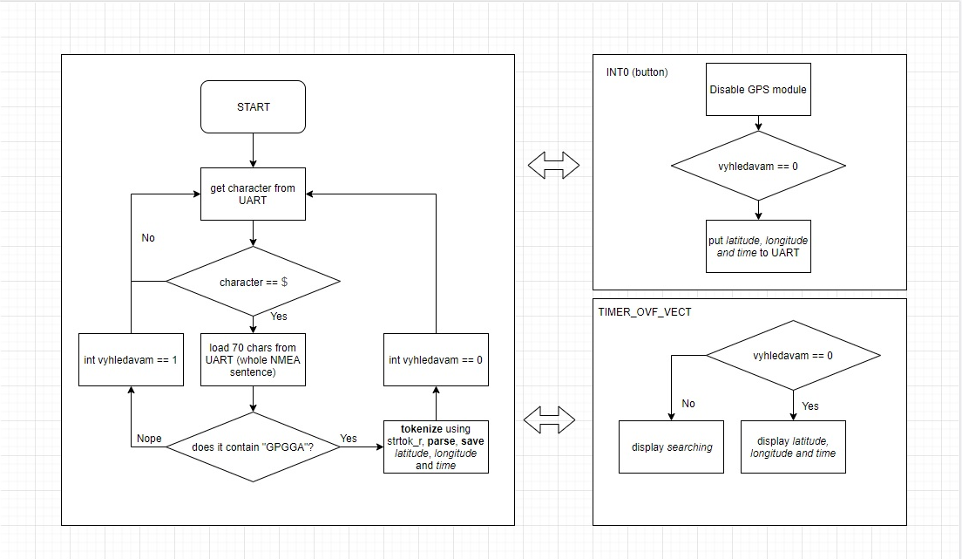

Slide 7
Video presentation
https://www.youtube.com/watch?v=jfIPIAEUn_A&feature=youtu.be

Slide 8

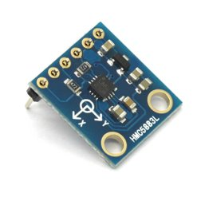

Extensions
Application "Where is Česká":
Module: Arduino compass HMC5883L
Direction towards Česká tram stop should be displayed instead of north on the compass
Calculation of angle to Česká from your position and orientation towards magnetic north
Generator of XML coordinate string:
Export and use in Google Earth

Slide 9
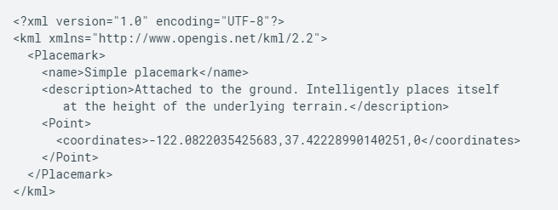

Slide 10
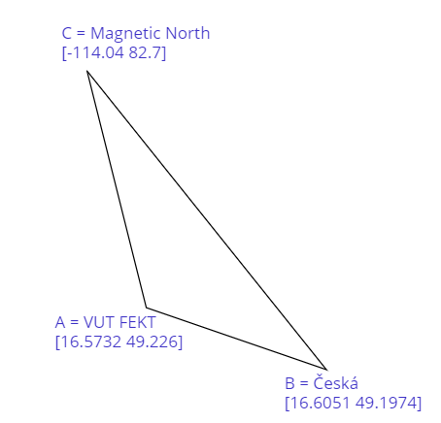
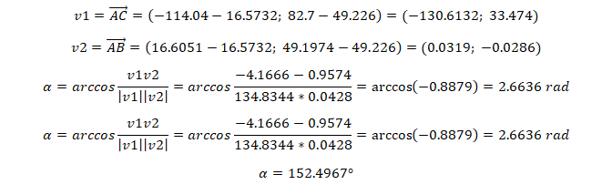

Č

Slide 11
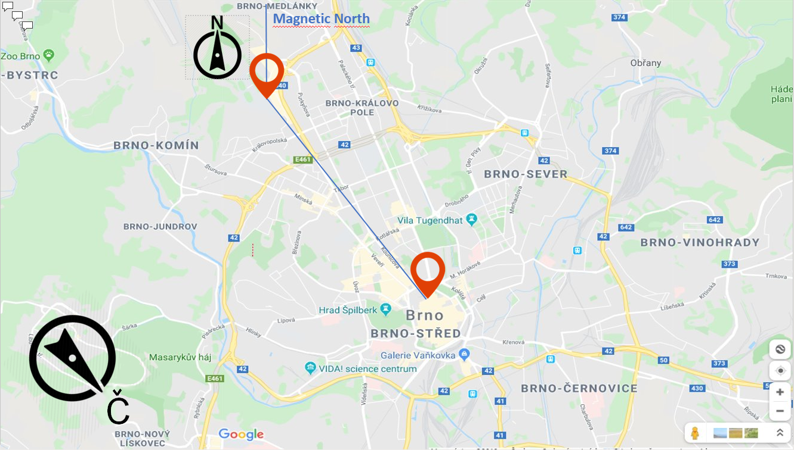

Slide 12
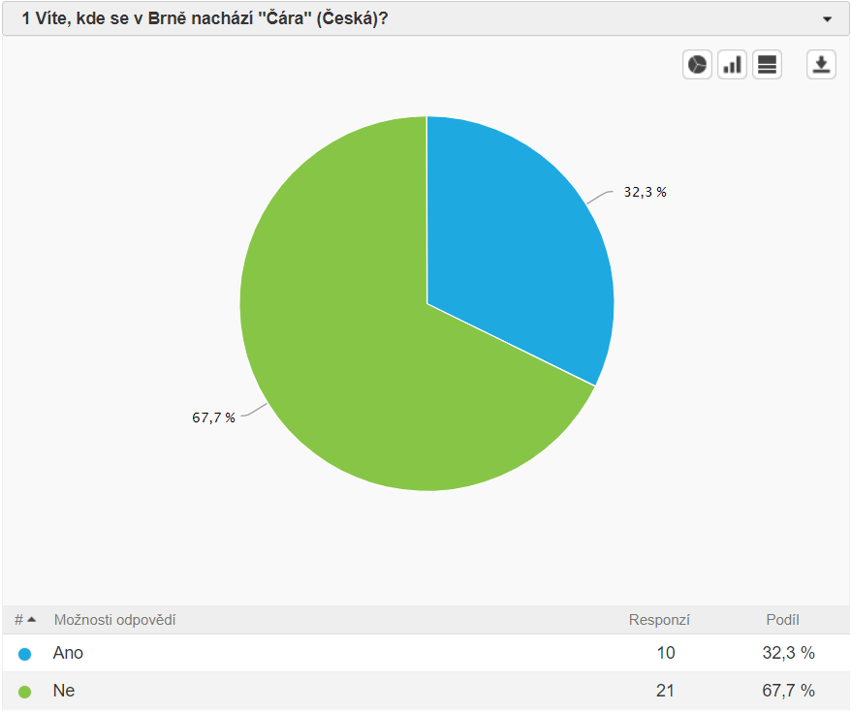
Results of our survey:

Slide 13
Sources
Sergey Denisov's library: avr-nokia 5110:
https://github.com/LittleBuster/avr-nokia5110
Connecting Nokia 5110 to Arduino:
https://navody.arduino-shop.cz/navody-k-produktum/lcd-displej-nokia-5110.html
GPS:
http://yopero-tech.blogspot.com/
http://www.tajned.cz/
Video:
https://www.youtube.com/watch?v=jfIPIAEUn_A&feature=youtu.be
KML exaple:
https://developers.google.com/kml/documentation/kml_tut

Slide 14
Thank you for your attention

